Slide 1
Instruction Level Parallelism
Prepared by: shafia hussain

Slide 2
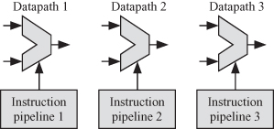
What is ILP
Instruction-level parallelism (ILP) is the parallel or simultaneous execution of a sequence of instructions in a computer program.

Slide 3
Introduction:
Overlap in instruction execution to achieve parallelism, e.g. pipelining.
ILP(Instruction-level parallelism ) via pipelining requires code scheduling to maximize
Two approaches
Dynamic (Hardware Based) in high end processors
Static (Software Based –Compiler) in low-end embedded devices

Slide 4
ILP
For typical RISC program branch freq is 15%-25%, meaning on average 3-6 instruction between branches.
Instructions inside these basic blocks also depend on each other which further reduces the degree of overlap required for ILP.
ILP across multiple blocks can be used to get substantial improvement
Another commonly used scheme is loop level parallelism.

Slide 5
Dependencies
The key to determining the amount of parallelism is knowing the dependencies
Three types
Data Dependencies
Name Dependencies
Control Dependencies

Slide 6
Data Dependencies
An instruction j is data-dependent on instruction i if either of the following holds:
Instruction i produces a result that may be used by instruction j.
Instruction j is data-dependent on instruction k, and instruction k is data dependent on instruction i.
The 2nd condition tells an idea. The chain of dependencies can be as long as a program
Dependent instruction cant be executed simultaneously
Processor with pipeline with interlocks will stall to avoid hazard
In a processor without the interlocks, it is the job of compiler to schedule in such a way that dependent instructions don’t overlap

Slide 7
Data Dependencies Example

Slide 8
Data Dependencies Solution
A dependence can be overcome in two different ways:
maintaining the dependence but avoiding a hazard through scheduling which can be done by both the compiler or the hardware (normally used).
eliminating a dependence by transforming the code.
Data dependencies involving registers are easy to detect
Dependencies involving mem locations (sw followed by a load having RAW) are difficult to detect because two addresses may refer to same location but look different or vice versa.
For example in C . We may write code such as
Array[i]=Array[i]+a
B=array[i]*2

Slide 9
Name Dependencies
Arise in Out of Order execution processors
When two instruction use the same register or memory location but there is no dataflow between them. There are two types
Suppose instruction ‘i’ precedes ‘j’
Antidependence: instruction j writes to a location from which i reads
Output Dependence: When ‘i’ and ‘j’ write to the same location. Order must be preserved.
Name dependent instruction can execute simultaneously by using register renaming, which can be done by compiler or hardware

Slide 10
Data Dependencies and Hazards
A hazard exists whenever there is dependence between instructions, and they are close enough that the overlap during execution would change the outcome of program. The hazard names actually tell the policy to avoid the hazard.
Consider instruction i precedes j. The possible data hazards are
■ RAW (read after write)—j tries to read a source before i writes it, so j incorrectly gets the old value.
■ WAW (write after write)—j writes an operand before it is written by i. The writes end up being performed in the wrong order, leaving the value written by i rather than the value written by j in the destination. Present only in pipelines that write in more than one pipe stage or allow an instruction to proceed even when a previous instruction is stalled.
■ WAR (write after read)—j tries to write a destination before it is read by i, so I incorrectly gets the new value. Occurs when instructions are reordered

Slide 11
Control Dependence
Determines correct order of instructions
In general, two constraints are imposed by control dependences:
An instruction that is control-dependent on a branch cannot be moved before the branch so that its execution is no longer controlled by the branch.
An instruction that is not control-dependent on a branch cannot be moved after the branch so that its execution is controlled by the branch.
In order execution processors automatically ensure that control dependences are also preserved.

Slide 12
Instruction Scheduling
To reorder instruction for exploiting max ILP while maintaining program correctness, two properties must be preserved
Dataflow
Exception : An unexpected event e.g. Overflow, invalid memory access
These two can be preserved by maintaining
data dependencies.
control dependencies.
If some technique e.g value prediction is reliable we can maintain correctness without maintaining data dependency

Slide 13
Example (Control Dependency)
New Exception
If we don’t maintain data dependency of x2 we may change program result
If we don’t consider the control dependency of ld instruction and move it above beq, it may generate an exception because ld should only run for x2 ≠ x0
Wrong Dataflow
X1 may come from sub or from add. So without preserving control dependencies, data flow may be wrong

Slide 14
Example (Control Dependency)
Sometimes program can correctly run while violating the control dependencies
Suppose x4 is unused after skip,(cause otherwise it maybe dest of any instruction before add and operand of any inst after or) then sub can be moved before beq. If branch is true then result of sub instruction remains unused

Slide 15
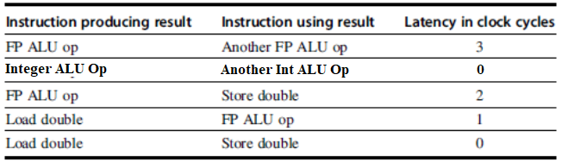
Basic Compiler Techniques of Static Scheduling: Loop Transformation
Assume the code above runs on RISC-V pipeline with functional unit latencies given in the table above.
Assume all the functional units are fully pipelined or replicated so that there is no structural hazard (i.e New instruction can be issued in each clock cycle)

Slide 16
Without any transformation applied, the compiled code is as follows
The code will run on RISC-V pipeline the following way (use the latency table)

Slide 17
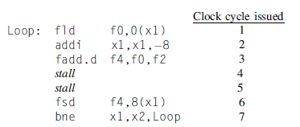
Scheduled Code
(Reordered)
The addi instruction is moved up before fadd.d

Slide 18
Loop Transformation: Loop Unrolling Without Scheduling (reordering)
Replicate the loop body
Reduces or eliminates the branch instruction
Following is a code with loop unrolling without scheduling
With 4 fld and fadd stalls and 8 fadd and fsd stalls, total cycles are 14+12=26. Which means that 26/4=6.5 cycles for each iteration . (Compared to 8 per each iteration of original . Because 6 instructions are reduced in total; 3 addi and 3 bne.

Slide 19
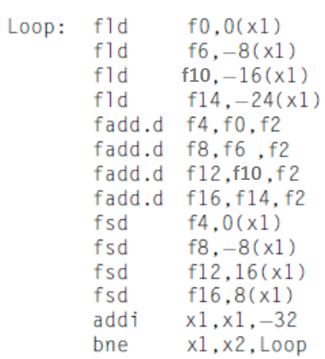
Loop Unrolling with scheduling
Scheduled Loop unrolling code takes 14 cycles for 4 iterations which means 14/4 = 3.5 cycles for single iteration whereas original code took 8 cycles

Slide 20

Loop Unrolling Limitation
Decrease in the amount of overhead amortized with each unroll
1
For example if Loop is unrolled 8 times, the new time for each iteration is 3.25 as compared to 3.5 for 4 times unroll
Code size limitations
2
Code size increases which may result in instruction cache miss
Register Pressure
3
Since loop unrolling increases register usage so it may result in shortage of registers

Slide 21
Reducing Branch Costs With Branch Prediction
Branch misprediction results in flushing the instruction fetched, so great emphasis should be given to improve prediction.
Types of Prediction
Fixed: Processor will follow one of the rules always either Predict Taken or Predict not Taken
Static: Processors have branch instructions that also indicate the result (their name as well as opcode). So Compiler or programmer can use them as a hint for processor if the result of branch is known

Slide 22
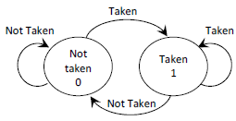
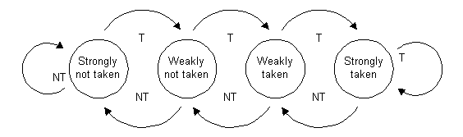
Types of Prediction
Dynamic: Maintain record of previous branches and predict next on the basis of these
Saturating Counter: Allocates an n-bit counter for each branch to save the state of branch results. The counter increments or decrements on a misprediction
1-bit counter: 0 means Not taken and 1 means taken. Good for Loops but is very limited.
2-bit Predictor: Better than 1-bit
but needs improvement. E.g. has 50% accuracy
if the branch alternated between True and False.

Slide 23
Two-level or correlating Predictor:
Also works good when a branch result depends upon previous branch instructions. A (m,n) two level predictor, considers the behavior of last m branches to predict. Since last m branches can have 2^{m} scenarios, so it uses a predictor for each scenario i.e 2^{m} predictors. The predictor size is n-bits.
Last m branches could be other branches, or the last two instances of current branch.
For example a (2,1) predictor predicts on the basis of last two branches which can be 00 (both no taken), 01, 10, 11(both taken). So there is a predictor for each scenario and of size 1-bit . We can see that if a branch alternates between taken and not taken, it’s prediction result will come from the predictors 01 and 10. They may give one misprediction but then onwards the prediction will be right

Slide 24
Example:
Example of a (2,2) branch predictor (16 different (2,2) predictors ) is shown in figure given below.
It has 2-bit Global Branch History Register because m=2 and thus 4 predictors for each branch.
It’s name is GBH because it is shared by all branches
The predictors are of size 2-bit as n=2
It supports 16 different branches and low order 4 bits of branch address are used to select horizontal location while 2-bit GBH is used to access the predictor
The number of bits in an
(m,n) predictor is
2^{m} x n x Number of prediction entries
A 2-bit predictor with no global history is simply a (0,2) predictor.

Slide 25
Example:

Slide 26
Gshare (Correlating Predictor)
It is not cost-effective to provide
an entry for every combination
of branch address and history so
there is some overlapping
XOR between branch address
and branch history is proven
experimentally to be a good
hashing function.

Slide 28
Tournament Predictor
It combines standard 2-bit predictor that uses local information and 2-level predictor.
The two are selected using a selector which is also a saturating counter array.
When the prediction is right the selector remains unchanged, otherwise if the prediction of other predictor is right the counter is incremented or decremented so that the other predictor is selected next time.

Slide 30
Dynamic Scheduling
In-Order-Issue
Out-of-order execution
Advantages
Makes code pipelined independent. Separate static scheduling is required for different pipelines
Also handles cases when dependents are unknown at compile time
Allows the processor to tolerate unpredictable delays, such as cache misses, by executing other code
Without dynamic scheduling 3rd instruction will also unnecessarily wait because of dependency between 1st and 2nd.

Slide 31
Dynamic Scheduling Problems
On the downside out of order execution introduces possibility of WAW and WAR hazards
In the code there is WAW hazard between 1st and 3rd and WAR hazard between 2nd and 3rd
Dynamic handling also makes Exception handling difficult.
Exception behavior must be preserved i.e exception should arise the same way they would arise in in-order processor.
It could also generate imprecise exceptions i.e. processor state does not look exactly as if the instructions were executed sequentially in strict program order so difficult to resume
The pipeline may have already completed instructions that are later in program order than the instruction causing the exception.
The pipeline may have not yet completed some instructions that are earlier in program order than the instruction causing the exception.

Slide 32
Dynamic Scheduling Using Tomasulo’s Approach
Devised for IBM 360/91 floating point unit.
It had only four double-precision floating-point registers, which limited the effectiveness of compiler scheduling.
RAW hazards are avoided by executing an instruction only when its operands are available
WAR and WAW hazards, which arise from name dependences, are eliminated by register renaming
Register renaming can also be done statically (compiler) but it was difficult for 360 which had 4 registers

Slide 33
Dynamic Scheduling Using Tomasulo’s Approach: Register Renaming
Two WAR hazards
fadd.d and fsub.d for f8
fsd and fmul.d for f6
One WAW hazard
fadd.d and fmul.d for f6
True dependencies also present
fdiv.d and fadd.d for f0
fadd.d and fsd for f6
fsub.d and fmul.d for f8
Assume two temporary registers S and T are available.
So register renaming can easily be done statically.

Slide 34
Tomasulo’s Algorithm: Processor Components

Slide 35
Tomasulo’s Algorithm : Processor Components
The description is for RISC-V processor which has slight differences as compared to IBM 360
IBM 360 also had register-memory instructions.
IBM 360 had pipelined functional units while RISC-V has multiple functional units
Each functional unit has a reservation station which consists of multiple fields described later.
Memory unit has load and store buffers
The outputs from functional units goes to a Comman Data Bus (CDB) which is connected to Resvation Stations, Store Buffers and the register file

Slide 36
Tomasulo’s Algorithm : Processor Components
The reservation stations hold the instruction and the operand values.
If the operand is not available, it stores the name of the functional unit that will produce the result
Load buffer can hold three types of data
address components
effective address after it is calculated
The data loaded from memory waiting for CDB
Store buffer also store three types of data.
address components
effective address after it is calculated
The data to write

Slide 37
Tomasulo’s Algorithm : Steps Issue
Instructions are issued from a FIFO queue
If reservation station is empty then instruction is issued
With operands if they are available
The ID of the functional unit producing operand if the operands are not yet available
No RAW hazard
If the reservation station is not empty, it is a structural hazard and instruction is not issued.
In order issue with operands copied to reservation stations also eliminates WAR hazard

Slide 38
Tomasulo’s Algorithm : Steps Execute
If the operands are not available, wait until it is computed.
The operand is written directly from functional unit to reservation station through the CDB
Loads and stores require a two-step execution process.
The first step computes the effective address which is then placed in the load or store buffer. Memory dependence is also maintained using this address
After that data is read or written to memory as soon as the memory unit and data (for store) is available
Exception behavior is maintained not executing an instruction until a branch that precedes the instruction in program order has completed

Slide 39
Tomasulo’s Algorithm : Steps Write Result
Result is written to reservation stations( also store buffers) and register file through CDB.
Latency is always greater or equal to 1 in contrast to in order pipelines where latency can be zero.
Reason is data is available after Write stage whereas in a standard 5-stage pipeline data is forwarded from execution stage.
The write is out of order which may cause imprecise exception. Solution will be discussed later

Slide 40
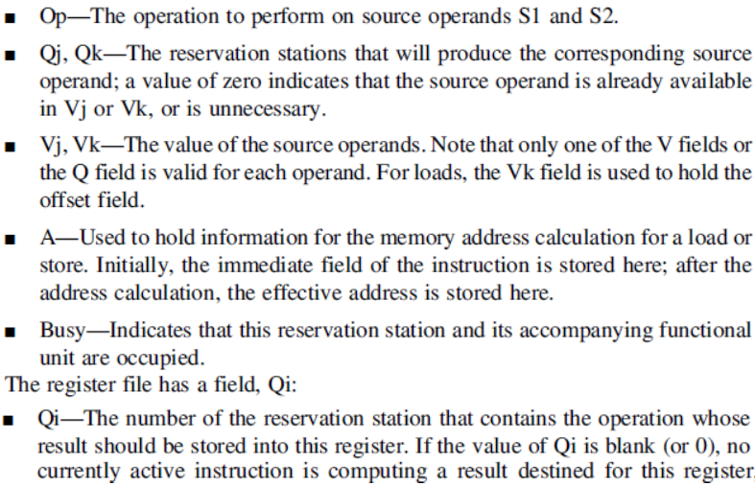
Tomasulo’s Algorithm Example
Before example we must know the detailed fields

Slide 41
Tomasulo’s Algorithm Example
All instructions are issued and only first load completed
All name dependencies will be resolved by renaming
True dependencies are:
3 is dependent on 2 for f2 which is load
4 is dependent on 1 and 2 for f2 and f6, both from load
5 is dependent on 1 and 3, load and mul
6 Is dependent on 2 and 4, load and sub (adder)

Slide 42
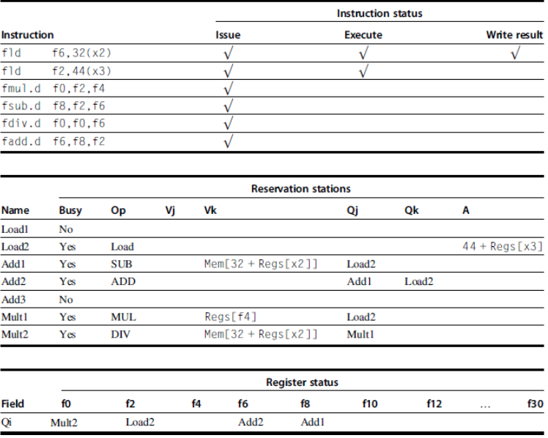
Example
Only 1st load has completed

Slide 43

Example
For example if an instruction has 2 cycle latency and is issued im 4th cycle and execution started in 5th, the dependent instruction following it can start execution 8th cycle. Because dependent following instruction will be issued in 5th and should start execution in 6th when latency is 0.
Solution
 | issue | Exe start | Exe End | write
fld f6,32(x2) | 1 | 2 | 2 | 3
fld f2,44(x3) | 2 | 3 | 3 | 4
fmul.d f0,f2,f4 | 3 | 5 | 10 | 11
fsub.d f8,f2,f6 | 4 | 5 | 6 | 7
fdiv.d f0,f0,f6 | 5
fadd.d f6,f8,f2 | 6 | 8 | 9 | 10
11 is dim to show that it is the next cycle and has not executed yet

Slide 44
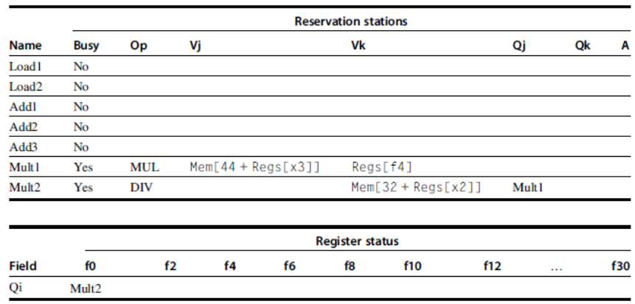

Slide 45
Tomasulo Algorithm: Dynamic Loop Unrolling
It was already discussed that ILP capability in basic block is limited, so it should be exploited across blocks.
Tomasulo algorithm delivers dynamic loop unrolling.
As will be seen in the coming example, instructions from multiple iterations of the loop reside in the processor at a time.
The no of iterations executing in parallel depends upon the no of functional units/reservation stations available and latency of instructions

Slide 46
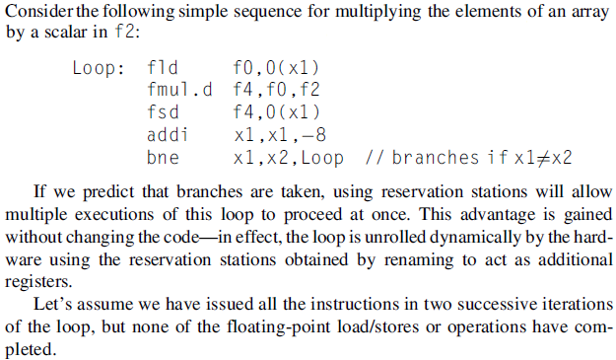
Tomasulo Loop Example

Slide 47
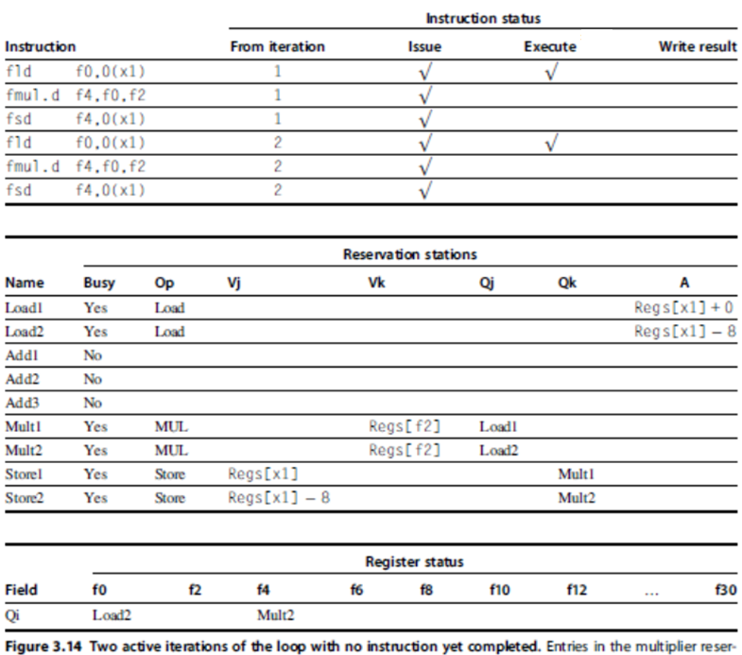

Slide 48
Tomasulo Algorithm: Dynamic Loop Unrolling
The loop example ignored branches. Actually in a processor without speculation no instruction is executed until the branch result is known
A load and a store can be done out of order, if they access different addresses.
If a load and a store access the same address, then following hazards may happen
perform
The load is before the store in program order and interchanging them results in a WAR hazard.
The store is before the load in program order and interchanging them results in a RAW hazard.
Similarly, interchanging two stores to the same address results in a WAW hazard.
Solution:
Perform the effective address calculations in program order. (issued in order and 1st execution step also in order)
Whenever load address is computed it must be compared with all store addresses already in buffer. If there is a match then that load should wait
Similar solution for store except it should check store buffer as well along with load buffer to avoid WAW

